Slide 1
IMPLEMENTATION OF PLANNING AT AA

Slide 2
BOSCH
Leading supplier of technology and services in the areas of Mobility Solutions, Industrial Technology, Consumer Goods, and Energy and Building Technology.
Additionally, Bosch has in India the largest development center outside Germany, for end to end engineering and technology solutions.

Slide 3
AA at BOSCH
AA stands for Automotive Aftermarket
AA Division at Bosch is responsible for the supply, sales and distribution of automotive parts
Automotive aftermarket is responsible for
Automotive Spare Parts & Accessories
Vehicle Diagnostics
Service Workshop Concept like Bosch Car Service

Slide 4
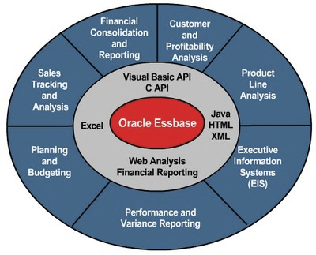
Introduction to tools
Hyperion Essbase

Slide 5
Essbase

Slide 6
Implementation of planning at AA
Project involves Creation of reporting, profit and loss, overhead costs for the business unit AA with the views: current, current forecast and business plan.

Slide 7
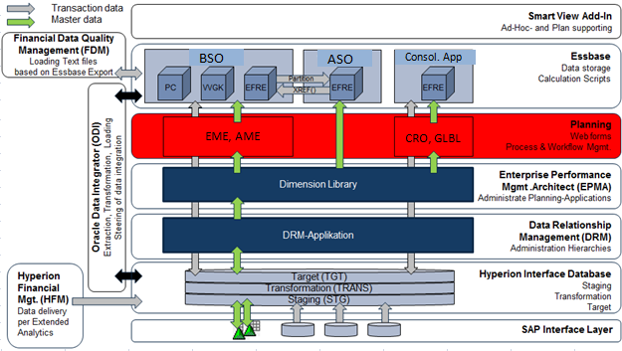
Architecture

Slide 8
Flow
SAP/BW
Integration Layer
Essbase
Excel
Hyperion Planning
(Web Application)
Web
Forms
Reports

